Slide 1
Award Winning
Academic English Programs

Slide 2
Who Are We?
OHLA is short for Open Hearts Language Academy.
OHLA has been providing exceptional ESL programs and language services since 1998.
Our programs are designed for international students who want to learn English in the USA and transition to University.

Slide 3
What Makes Different?
Outstanding University Pathway Program, partnered with over 67+ top tier universities.
Highly recognized academic English programs, fully accredited by CEA.
Locations in Miami, Aventura, Boca Raton, Orlando-Celebration and Tampa. Our Award Winning English Program is also available ONLINE.
A true international school with a student population of over 70 nationalities.

Slide 4
Levels Offered at ?
There are a total of 8 English levels. Each level is 10 weeks.
On the first day at OHLA, students will be tested to see in which level they belong.
Basic I
Basic II
Intermediate I
Intermediate II
Advanced I
Advanced II *
Elite *
Elite Plus
* No TOEFL or IELTS with our partnered Universities

Slide 5
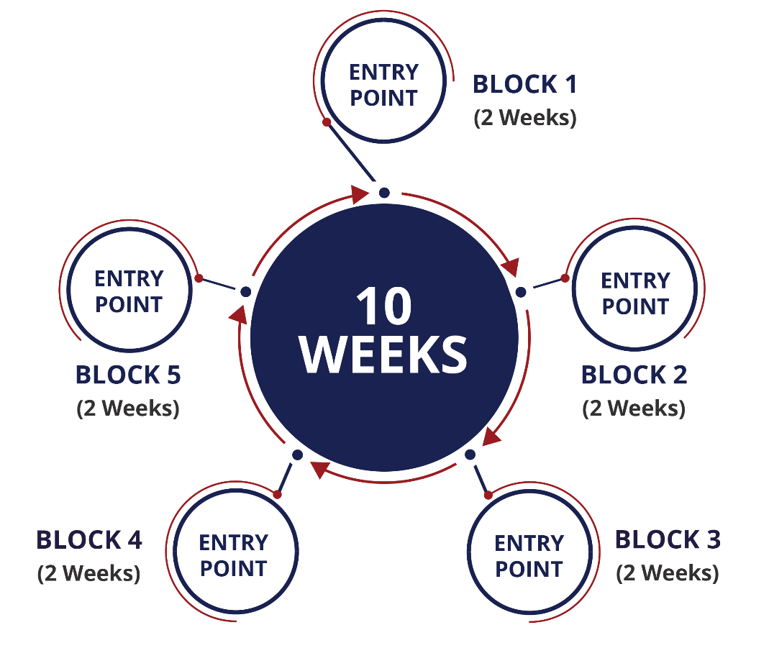
Session Entry Point
Levels are subdivided in 2-week units called “blocks”. Students may commence their studies at the beginning of any block, every second Monday of the month.

Slide 6
What Else Should I Know?
Minimum Age Requirement: 16 years of age
Average Class Size: 12 students
Maximum Class Size: 15 students
However, for the One-to-One Program it is 11 years of age
Duration of Each Lesson: 50 minutes
Accommodations Offered: -Homestay (Single & Double)
-Student Residence (Single, Double, Multiple)
Free English Elective: Every Friday

Slide 7
About Our University Pathway Program
Upon completion of our Advanced 2 Level, students gain direct acceptance into our partnered Universities and Colleges throughout the United States.
NO TOEFL OR IELTS REQUIRED!
OHLA through its Sister Company UniApplyNow offers University Admission to Bachelors, Masters and PhD degrees and to over 11,000 degree programs with top tier US Universities and Colleges

Slide 8
Head Office Campus
825 Brickell Bay Drive. Tower 3 18th Floor
Miami, FL 33131
T: +1 305-379-4027
Toll Free: 1-855-OHLA-NOW (1-855-645-2669)
info@ohla.com – www.ohla.com

